Slide 1

Notes:
Introduce yourself and the project: a hostel accommodation and student services system with a normalised database design and a web interface called HostelHub.

Slide 2
Problem statement
OVERVIEW
Problem | Effect on the hostel office
Double-booked beds | One bed can be assigned to two students
Rooms over capacity | Nothing limits the number of beds placed in a room
Missed fee dues | Payments are tracked in separate sheets
Complaints never closed | No single place to follow a request to resolution
Objective: one consistent database and interface that prevents these errors by design.
Notes:
Manual hostel records are kept in separate registers. That leads to four recurring problems, shown in the table. The project removes each of them through database design and interface rules.

Slide 3
Solution architecture
OVERVIEW
Users
Interface
Application logic
Data layer
Warden, accounts officer, administrator
HostelHub: seven screens in HTML and CSS
Validation and allocation rules in JavaScript
Relational schema in MySQL, 17 tables
Design
Enforce
Operate
17 entities converted to 17 relations in Third Normal Form
Constraints, partial unique indexes, 6 triggers and 8 views in SQL
HostelHub web interface with 7 screens built in VS Code
Notes:
Four layers: users, the HostelHub interface, application logic and the data layer. In the current demo the interface works on sample data held in the browser; the relational schema is the specification of the data layer and the planned connection is to MySQL.

Slide 4
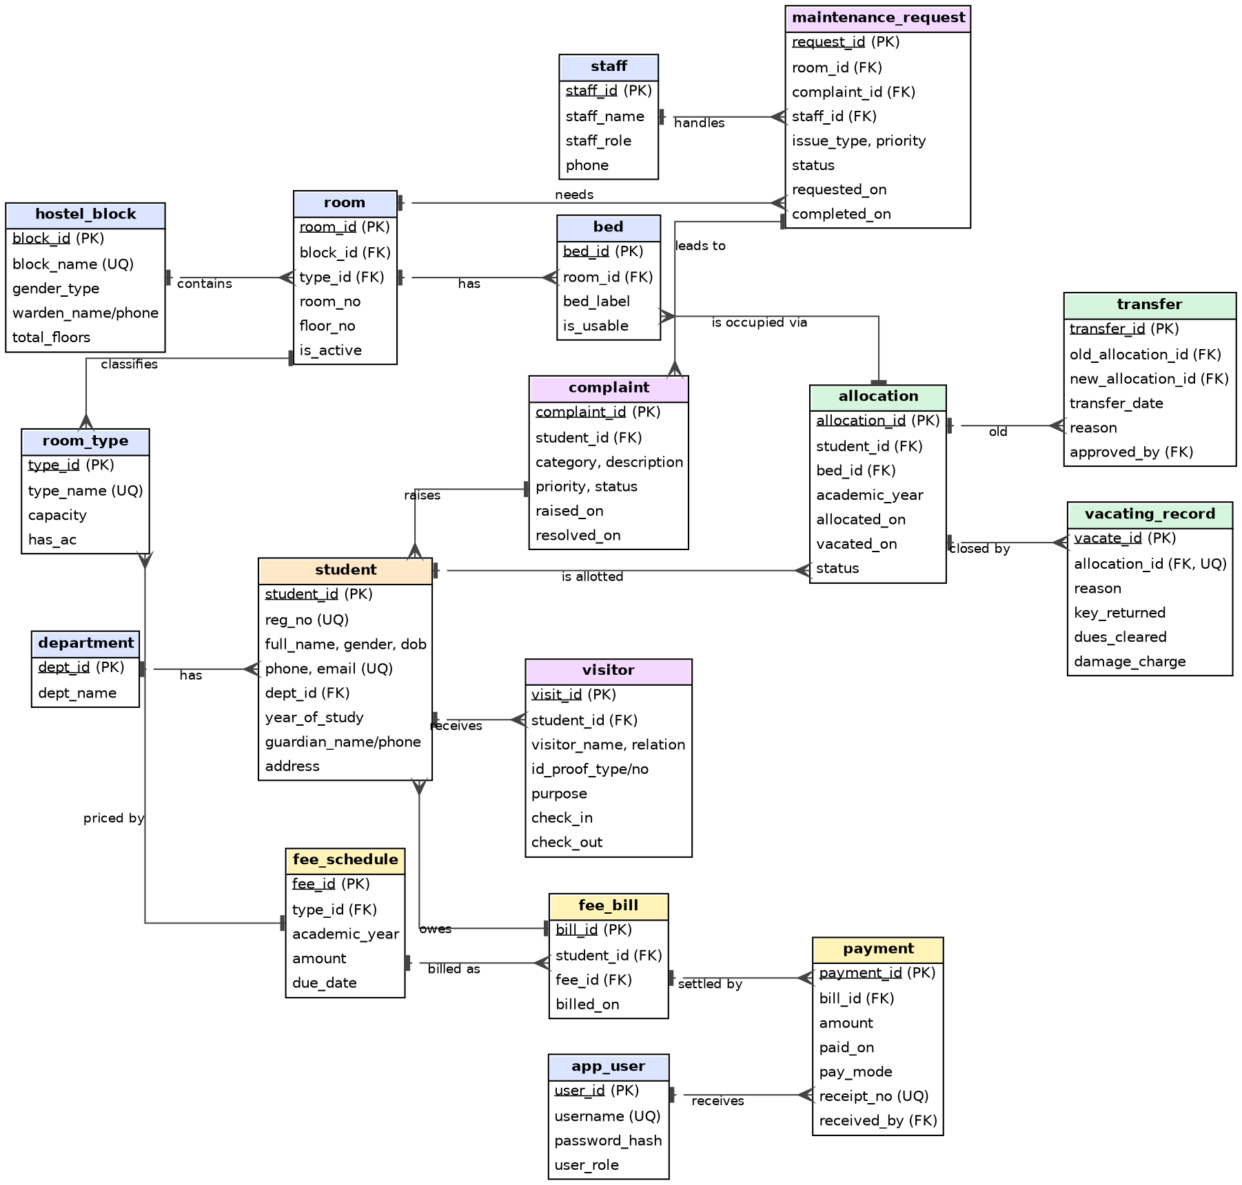
ER diagram
DATABASE DESIGN
17 entities and 18 one-to-many relationships
Crow’s-foot notation: a bar means one, a crow’s foot means many
Core chain: student → allocation ← bed ← room ← block
Fees, visitors, complaints and maintenance hang off students and rooms
Notes:
Walk the diagram from student to allocation to bed to room to block. The fee tables (schedule, bill, payment) and the service tables (visitor, complaint, maintenance) connect to students and rooms.

Slide 5
Normalisation to 3NF
DATABASE DESIGN
All 17 relations are in 3NF. Every fact is stored once.
Redundancy removed | Where it is now stored
Room capacity | room_type (not repeated in every room)
Fee amount | fee_schedule (bills refer to it by fee_id)
Date a student left | allocation.vacated_on only
Block gender | hostel_block (reached through room)
Occupancy and balance | Computed by views, never stored
Notes:
All 17 relations are in Third Normal Form, and in BCNF because every determinant is a candidate key. Each redundancy was removed so that every fact is stored once.

Slide 6
Integrity rules enforced by the database
DATABASE RULES AND RESULTS
Business rule | Enforced by | Test result
One active resident per bed | Unique index + capacity trigger | N-01 rejected
One active allocation per student | Partial unique index | N-02 rejected
Gender-matched blocks | Trigger | N-03 rejected
Valid allocation dates | CHECK constraint | N-04 rejected
Payment never above fee | Trigger | N-05 rejected
Beds never above room capacity | Trigger | N-06 rejected
Visitors only for residents | Trigger | N-07 rejected
11 of 11 rule-breaking statements were rejected by the database.
Notes:
These rules live in the database, so they hold even if an application is bypassed. Each was tested with a deliberate violation, and the database rejected every one.

Slide 7
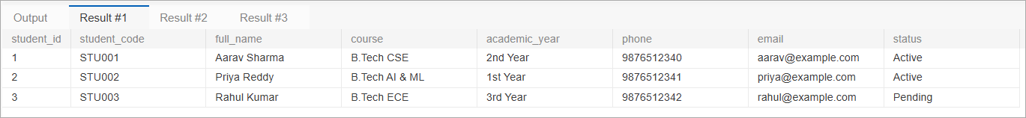
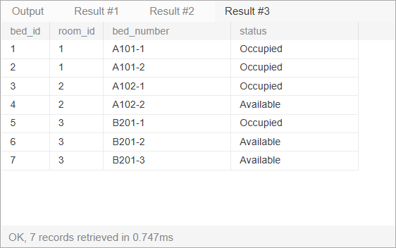
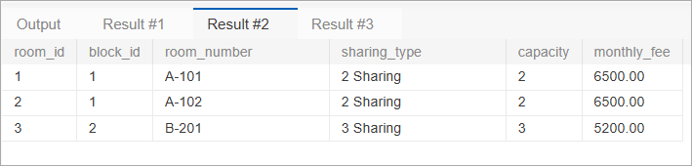
Database results (MySQL)
DATABASE RULES AND RESULTS
students: 3 records (2 Active, 1 Pending)
rooms: 3 records, total capacity 7 beds
beds: 7 records (4 Occupied, 3 Available)
Notes:
These are result screenshots from the MySQL database. Seven beds match the total room capacity of seven, and four of them are occupied.

Slide 8
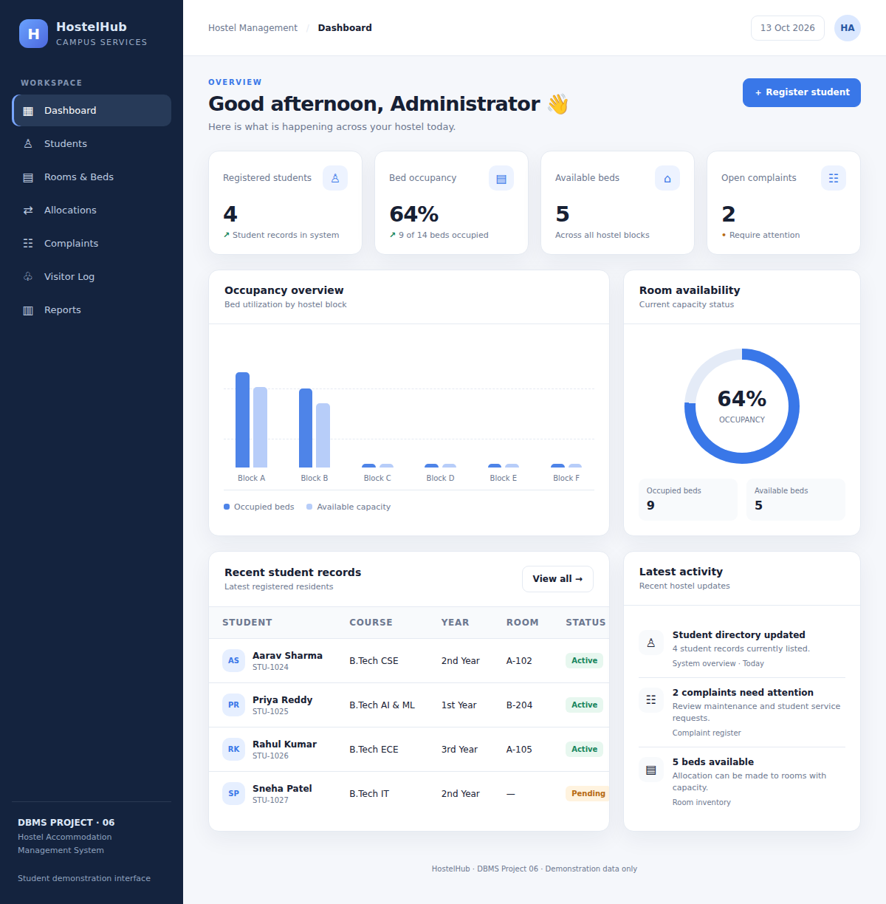
Dashboard
HOSTELHUB INTERFACE
What it does
Seven screens: dashboard, students, rooms and beds, allocations, complaints, visitor log and reports
64% bed occupancy: 9 of 14 beds occupied, 5 available
4 registered students and 2 open complaints
Figures update as soon as a bed is allocated or a complaint is resolved
Notes:
The dashboard shows registered students, bed occupancy, available beds and open complaints. The cards are calculated from the records, so they change as soon as you act. The other screens are students, rooms and beds, allocations, complaints, visitor log and reports.

Slide 9
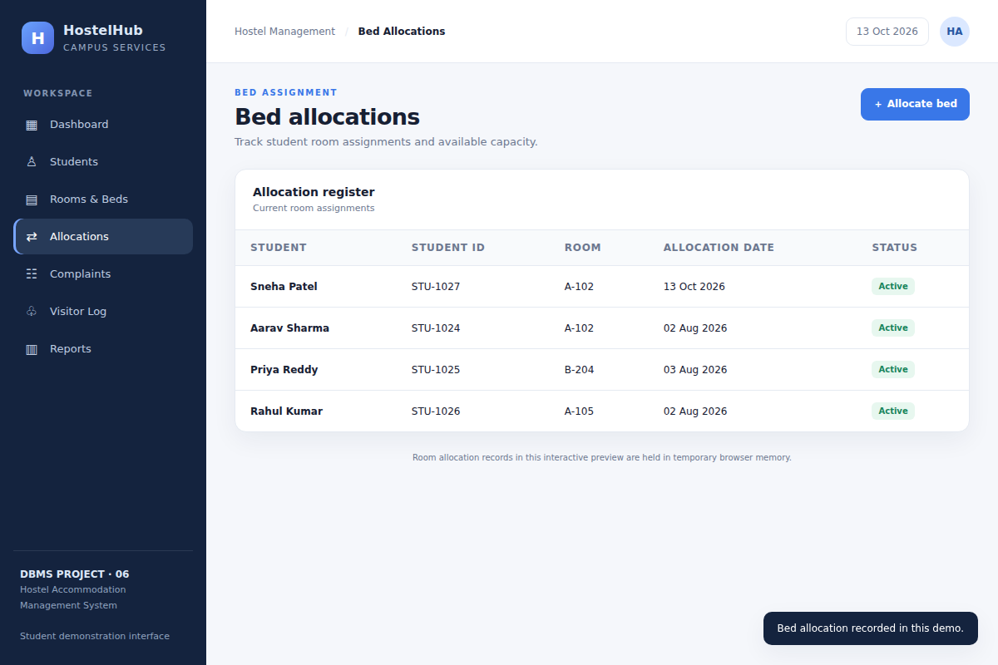
Bed allocation
HOSTELHUB INTERFACE
What it does
Only students without a room are offered
Only rooms with a free bed are offered
A full room can never be chosen
Occupancy and the register update at once
Notes:
Allocation offers only unallocated students and rooms with free capacity, so double allocation and over-capacity cannot happen in the interface.

Slide 10
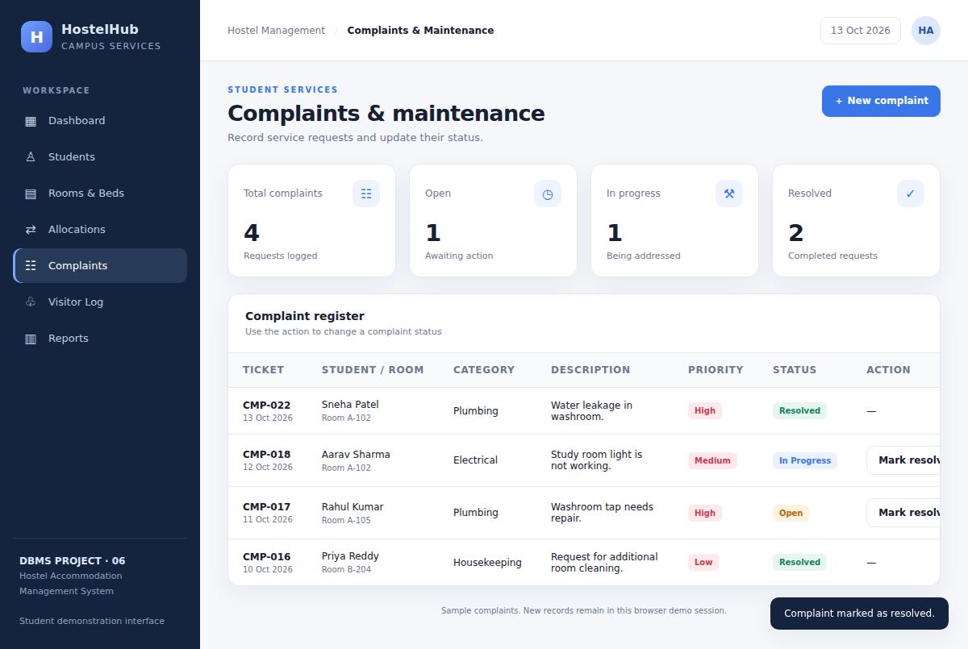
Complaints and maintenance
HOSTELHUB INTERFACE
What it does
Category, priority and status for every request
Status moves from Open to Resolved
Summary cards show open, in-progress and resolved counts
Notes:
Complaints carry priority and status and are marked resolved from the register.

Slide 11
Testing and results
RESULTS
Area | Tests | Result
HostelHub interface | 18 | All passed
Database rule violations | 11 | All rejected
JavaScript errors during the run | – | None
Selected tests
HT-09 | Only rooms with a free bed are offered (4 of 6)
HT-13 | No unallocated students: confirm button disabled
N-03 | Male student in a female block rejected by trigger
N-05 | Payment above the billed fee rejected by trigger
Notes:
Eighteen interface tests were run automatically against the page and all passed, with no JavaScript errors. Eleven rule-breaking SQL statements were all rejected by the database.

Slide 12
Conclusion and future scope
RESULTS
Conclusion
Future scope
17-entity design normalised to 3NF
SQL rules: constraints, triggers and views
HostelHub with 7 screens
29 tests passed: 18 interface, 11 database
Connect HostelHub to MySQL
Fee, transfer and vacating screens
Login with user roles
Fee-due notices and report export
Notes:
We delivered a normalised design, database-level rules and a working interface. The main next step is connecting HostelHub to the MySQL database and adding the fee, transfer and vacating screens. Thank the audience and invite questions.

Slide 13


